Slide 1
Day 4 – Java Core Platform
Java Collection Framework
Course Code: TAPL1LF011 Course Name: Core Java
Trainer Name: Thiruppathi
Java Trainer

Slide 2
Learning Outcome – Session 2
What Are Collections and Why Use Them?
Introduction
The Problem with Arrays
Why You Should Use Collections
Defining and Iterating Collections
Introduction
Collection of Collections
Collection Behaviors
Collections with Iteration Order: Lists And Set
Introduction
Key Features
Coding with Lists

Slide 3
JCF – Java Collection Framework v1.5
Collection framework is about the architecture that manipulates the data.
Collection is a unit of storage of group of elements.
It contains the interfaces and Classes.
It provides support of algorithm.

Slide 4
Problem in Arrays
Arrays are fixed in size.
Arrays can hold only the same type of data.

Slide 5
Why to use collection
Collection is group of interrelated data.
It is growable in nature.
Collection set of methods to process.

Slide 6
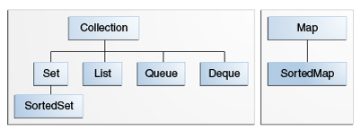
Java Collection Framework

Slide 7
Collection interface
The Collection interface is the least common denominator that all collections implement.
Used to pass collections around and to manipulate them when maximum generality is desired.
Some types of collections allow duplicate elements, and others do not.
Some are ordered and others are unordered.

Slide 8
List Interface
an ordered collection (sometimes called a sequence).
Lists can contain duplicate elements.
The user of a List generally has precise control over where in the list each element is inserted and can access elements by their integer index (position).
Contain the Implemented classes are: Vector(legacy) 1.1, ArrayList and LinkedList

Slide 9
ArrayList - class
Resizable-array implementation of the List interface.
Implements all optional list operations, and permits all elements, including null.
Provides methods to manipulate the size of the array that is used internally to store the list.
Not a Synchronized.

Slide 10
Thank you
Any Queries?

